Slide 1
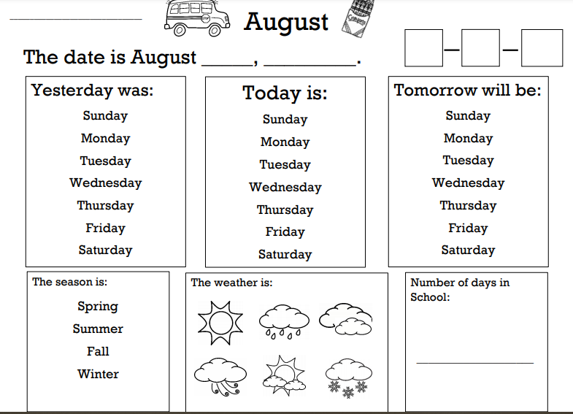

Slide 2
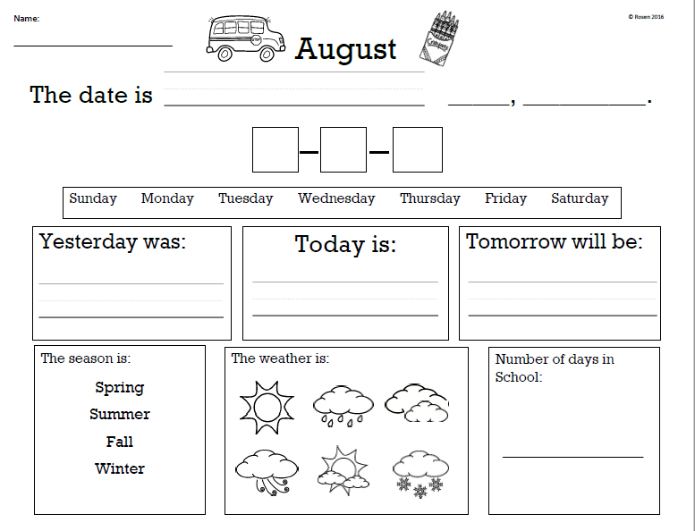

Slide 7
______/________/_______
Month/ Day/ Year
My schedule for today is:
1st Block:
Breakfast
AM Jobs
Pledge & Announcements
2nd Block:
Calendar & Task
Class Lesson
Class Activity
3rd Block:
Lunch
Elective
Water Break
4th Block:
Current Events
PM Jobs
Computer
My job today is
____________________________.
Our lesson is about _________________________.
My 3rd block elective is _______________.

Slide 8
______/________/_______
Month/ Day/ Year
My schedule for today is:
1st Block:
________________
________________
________________
2nd Block:
_________________
_________________
_________________
3rd Block:
_________________
_________________
_________________
4th Block:
__________________
__________________
__________________
My job today is
____________________________.
Our lesson is about _____________________________.
My 3rd block elective is _______________.
I had a good day!
Comments:__________________________________________________________________

Slide 9
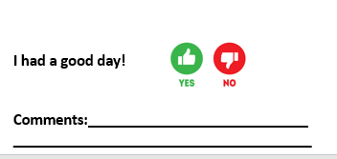

Slide 10
Isaiah: Towels, Uniforms Adam: Library, Green Folders, Mailbox Antonio: Shredding, Copies Jaden: Ids, Copy Room, Paper Delivery (F-K), Date Xander: Construction Area Adrian: Coffee, Uniforms Alex: Towels, Paper Deliveries (A-E)
MORNING JOBS

Slide 11
AFTERNOON JOBS
Isaiah: Uniforms
Adam: Green Folders
Antonio: Wash Bottles
Jaden: Copy Room
Xander: Vacuum
Adrian: Coffee Pot
Alex: Trash

